Slide 1
Contract RAG Prototype
Multi-Agent Retrieval-Augmented Question-Answering System

Slide 2
Problem Statement
    Legal and compliance teams face challenges when analysing large contract repositories:
    Manual Review Burden: Hours spent searching documents for specific clauses, obligations, and risk indicators
    Information Retrieval Gap: Traditional keyword search misses semantic relationships and contextual meanings
    Risk Visibility: Critical risk clauses (unlimited liability, broad indemnification, etc.) are often buried and overlooked
    Compliance Complexity: Lack of structured analysis of legal concepts (obligations, liability caps, termination rights)
    Audit Trail: Manual review lacks reproducibility and clear citation trails

Slide 3
✓ Semantic Search: Find clauses by meaning, not just keywords
✓ Hybrid Retrieval: Combine keyword-based & semantic retrieval
✓ Evidence Grounding: Answers backed by contract excerpts
✓ Multi-Intent Support: Handle QA, risk scans, conflict detection
✓ Legal Structure Extraction: Parse clauses into structured concepts
✓ Risk Scoring: Identify high/medium/low severity patterns

Slide 4
Functional Requirements
✓ Semantic Search: Find clauses by meaning, not just keywords
✓ Hybrid Retrieval: Combine keyword-based & semantic retrieval
✓ Evidence Grounding: Answers backed by contract excerpts
✓ Multi-Intent Support: Handle QA, risk scans, conflict detection
✓ Legal Structure Extraction: Parse clauses into structured concepts
✓ Risk Scoring: Identify high/medium/low severity patterns

Slide 5
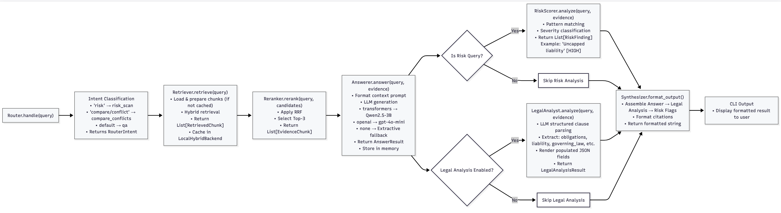

Slide 6
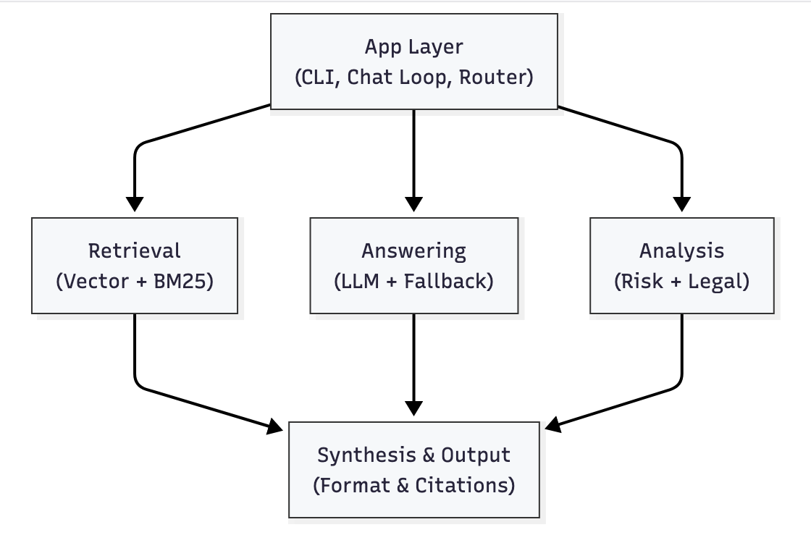
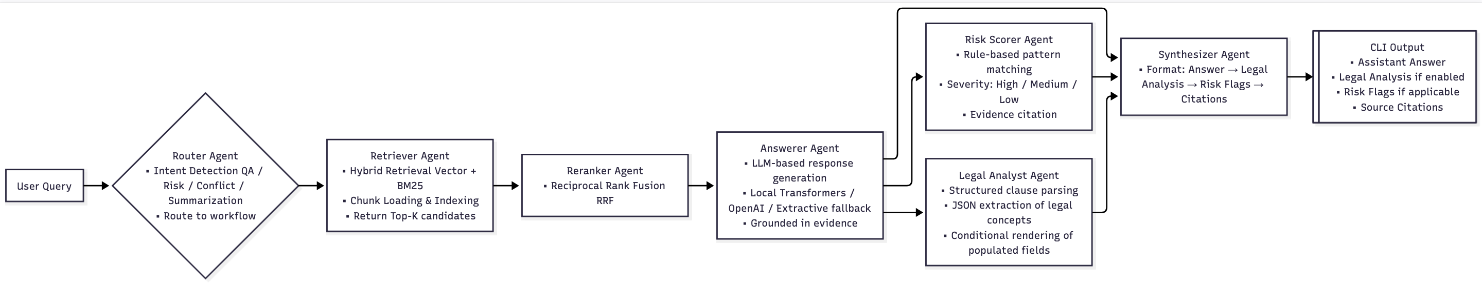

System Architecture

Slide 7
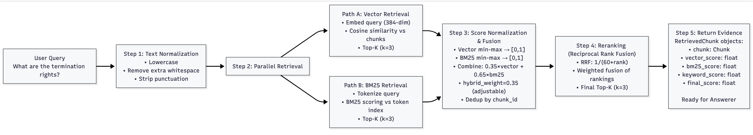
RAG Ingestion workflow
Agent Interaction flow

Slide 8
Design Decisions

Slide 9
Chunking Strategy
Decision: Heading-Aware, Overlap-Based Chunking
Rationale:
Semantic Boundaries: Legal documents have explicit section structure (1., 1.1, 2., etc.)
    Respect these natural boundaries to preserve clause context
    "Termination" is Section 3.2; grouping related sentences keeps meaning intact
Overlap for Context: 120-char overlap window
    Prevents edge cases where relevant info falls between chunks
    Example: If "Termination" clause spans two chunks, overlap ensures transition is smooth
Heading Metadata: Each chunk carries:
Chunk: id: "doc_001_chunk_015"
section_number: "3.2”
section_title: "Termination Rights"
text: "[normalized clause text]"
    Enables better synthesis (citations show "Section 3.2")
    Supports filtering by section type
Alternative Considered: Sliding Window (Rejected)
Pros: Simple, uniform chunk size
Cons: Breaks semantic boundaries, loses section structure, harder to cite
Observed Outcomes
Typical contract (25KB) → ~60-100 chunks
4-document corpus → ~250-300 chunks
Retrieval time: <50ms for top-3
Configuration
Parameter | Value | Justification
target_chunk_size | 900 chars | ~300 tokens; balances semantic completeness with retrieval precision
chunk_overlap | 120 chars | ~40 tokens; minimal but sufficient for context continuity
heading_regex | ^(\d+\.)*\d+\s+ | Matches numbered sections (e.g., "2.3.1 ")

Slide 10
Embeddings Strategy
Decision: Sentence-BERT (all-MiniLM-L6-v2) + BM25
  Selected Model: sentence-transformers/all-MiniLM-L6-v2
  Characteristics:
  Architecture: DistilBERT-based sentence embeddings
  Dimension: 384 (vs. 768 for full BERT, 1536 for OpenAI)
  Parameters: 22M (lightweight, <200MB memory)
  Why This Choice:
  Legal Domain Applicability:
    Trained on diverse corpora (including legal-adjacent datasets)
    Captures semantic similarity for contract language
    Example: "termination by either party" ≈ "right to terminate" (high cosine similarity)
  Efficiency for Lightweight Deployment:
    384-dim embeddings → fast cosine similarity computation
    Batch processing: 1000 chunks in <2 seconds
    Memory efficient: 250 chunks × 384 floats = ~390KB
  Hybrid Complementarity:
    Semantic (vector) captures meaning
    BM25 captures exact terminology matches
    Combined: "liability" + semantic meaning → strong recall
Alternative Considered: OpenAI Embeddings (text-embedding-3-small)
Pros: State-of-the-art, 1536-dim, legal domain coverage
Cons: API cost, latency, no offline fallback
Decision: Not for prototype; local model preferred for deployability
Alternative Considered: Dense Passage Retrieval (DPR)
Pros: Jointly trained retriever & reader, strong legal domain potential
Cons: Larger model (300M+), requires GPU, training overhead
Decision: Overkill for 4-document prototype; all-MiniLM sufficient

Slide 11
Enhancements for Production
🧠 1️⃣ Advanced Multi-Agent Orchestration
Dynamic agent routing based on query intent
Conflict Detection Agent (cross-agreement inconsistency checks)
Legal Risk Escalation Agent for high-exposure clauses
Self-reflection / answer verification loop
Confidence scoring per response
📊 2️⃣ Evaluation & Monitoring
Automated regression testing on query benchmark set
RAG evaluation metrics:
  Retrieval Recall@K
  Answer groundedness
  Hallucination rate
LLM-as-a-judge scoring pipeline
⚡ 3️⃣ Performance & Scalability
Vector database (Pinecone)
🏗 4️⃣ Improved RAG Pipeline
Smarter chunking (semantic + clause-aware)
Hybrid retrieval (BM25 + vector search)
Cross-encoder reranking
Query rewriting agent
🤖 5️⃣ Model Improvements
Fine-tuned legal LLM (LoRA on 7B model)
Multi-model fallback chain
Guardrail model for hallucination detection

